Slide 1
Assembling metagenomes: a not so practical guide
C. Titus Brown
Assistant Professor
CSE, MMG, BEACON
Michigan State University
September 2013
ctb@msu.edu

Slide 2
Acknowledgements
Lab members involved
Collaborators
Adina Howe (w/Tiedje)
Jason Pell
Arend Hintze
Rosangela Canino-Koning
Qingpeng Zhang
Elijah Lowe
Likit Preeyanon
Jiarong Guo
Tim Brom
Kanchan Pavangadkar
Eric McDonald
Jim Tiedje, MSU; Janet Jansson, JGI; Susannah Tringe, JGI.
Funding
USDA NIFA; NSF IOS; BEACON, NIH.

Slide 3
Acknowledgements
Lab members involved
Collaborators
Adina Howe (w/Tiedje)
Jason Pell
Arend Hintze
Rosangela Canino-Koning
Qingpeng Zhang
Elijah Lowe
Likit Preeyanon
Jiarong Guo
Tim Brom
Kanchan Pavangadkar
Eric McDonald
Jim Tiedje, MSU; Janet Jansson, JGI; Susannah Tringe, JGI.
Funding
USDA NIFA; NSF IOS; BEACON, NIH.

Slide 4
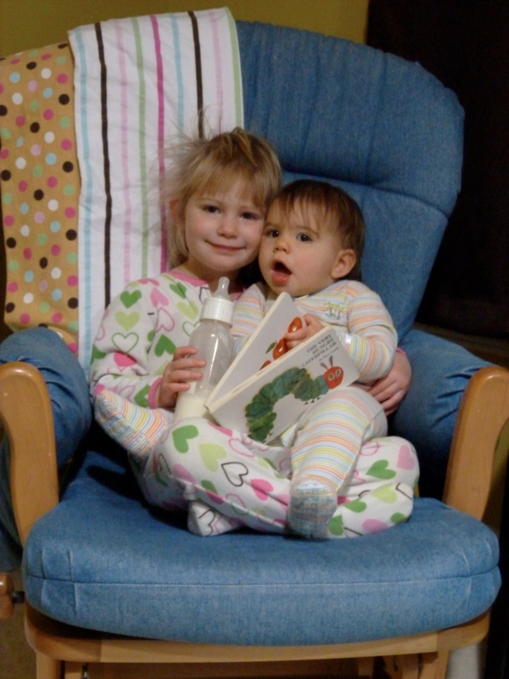

Slide 5
Shotgun sequencing and coverage
“Coverage” is simply the average number of reads that overlap
each true base in genome.
Here, the coverage is ~10 – just draw a line straight down from the top through all of the reads.

Slide 6
Random sampling => deep sampling needed
Typically 10-100x needed for robust recovery (300 Gbp for human)

Slide 7
Coverage distribution matters!
(MD amplified)

Slide 8
Assembly depends on high coverage

Slide 9
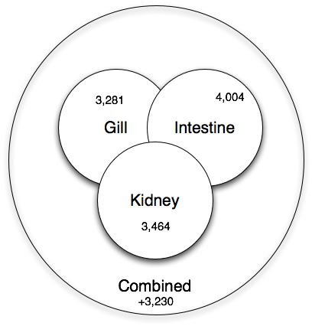
Co-assembly is important for sensitivity
Shared low-level transcripts may not reach the threshold for assembly.

Slide 10
K-mer based assemblers scale poorly
Why do big data sets require big machines??
Memory usage ~ “real” variation + number of errors
Number of errors ~ size of data set

Slide 11
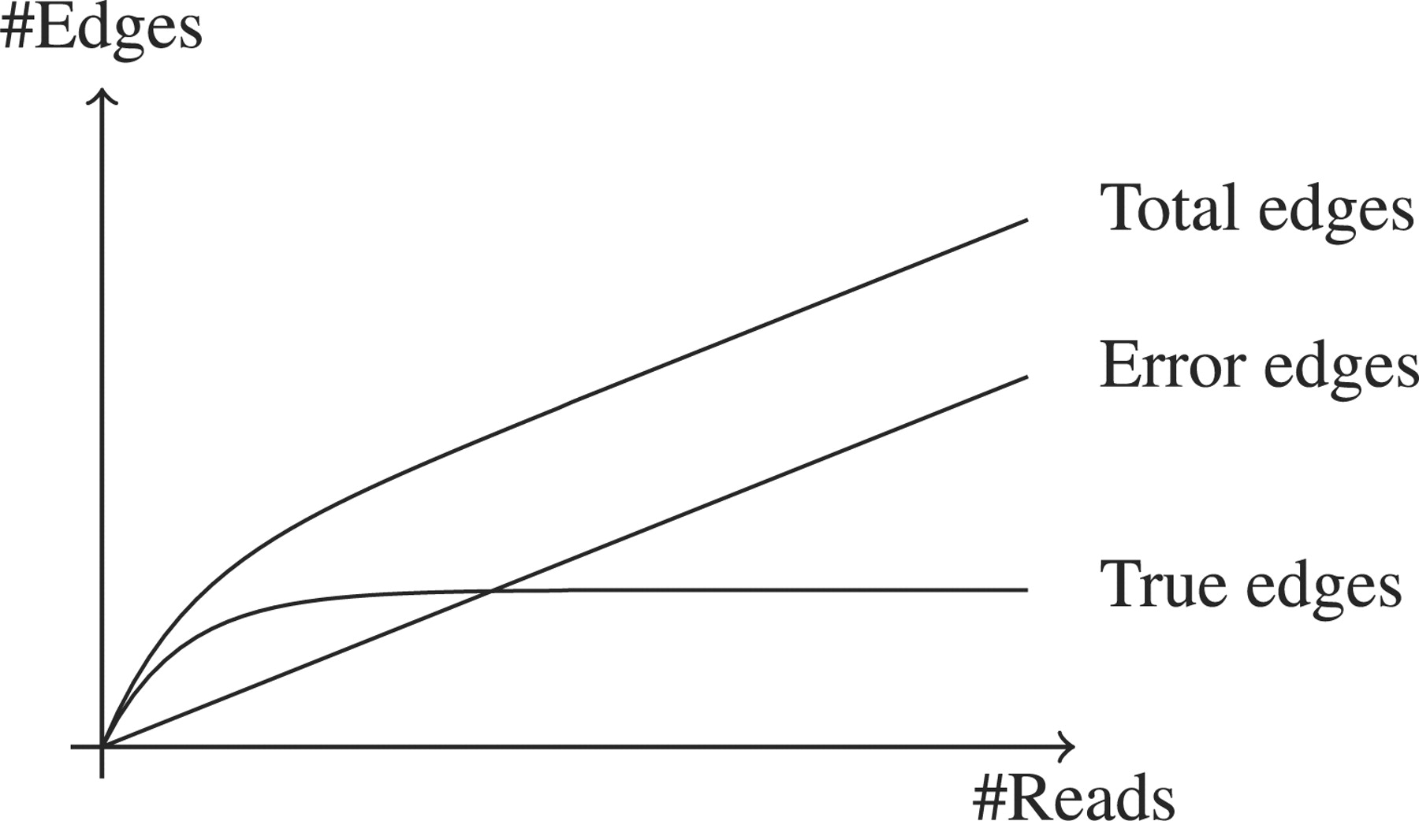

De Bruijn graphs scale poorly with data size
Conway T C , Bromage A J Bioinformatics 2011;27:479-486
© The Author 2011. Published by Oxford University Press. All rights reserved. For Permissions, please email: journals.permissions@oup.com
Notes:
A sketch showing the relationship between the number of sequence reads and the number of edges in the graph. Because the underlying genome is fixed in size, as the number of sequence reads increases the number of edges in the graph due to the underlying genome that will plateau when every part of the genome is covered. Conversely, since errors tend to be random and more or less unique, their number scales linearly with the number of sequence reads. Once enough sequence reads are present to have enough coverage to clearly distinguish true edges (which come from the underlying genome), they will usually be outnumbered by spurious edges (which arise from errors) by a substantial factor.

Slide 12
Practical memory measurements
Velvet measurements (Adina Howe)

Slide 13
How much data do we need? (I)
(“More” is rather vague…)

Slide 14
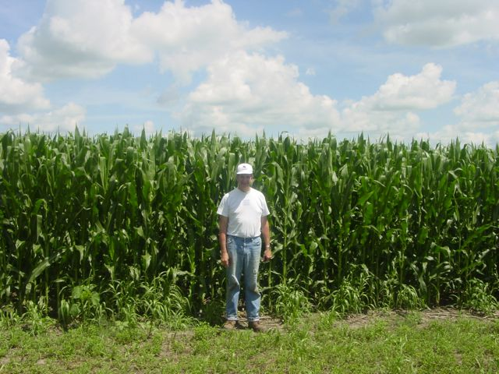
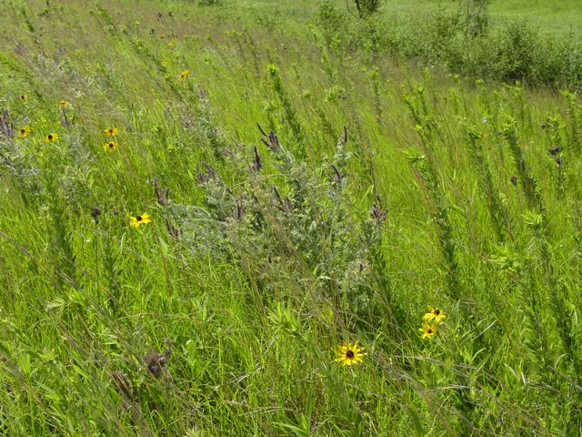
Assembly results for Iowa corn and prairie (2x ~300 Gbp soil metagenomes)
Total Assembly | Total Contigs (> 300 bp) | % Reads Assembled | Predicted protein coding
2.5 bill | 4.5 mill | 19% | 5.3 mill
3.5 bill | 5.9 mill | 22% | 6.8 mill
Putting it in perspective:
Total equivalent of ~1200 bacterial genomes
Human genome ~3 billion bp
Adina Howe

Slide 15
Resulting contigs are low coverage.

Slide 16
How much? (II)
Suppose we need 10x coverage to assemble a microbial genome, and microbial genomes average 5e6 bp of DNA.
Further suppose that we want to be able to assemble a microbial species that is “1 in a 100000”, i.e. 1 in 1e5.
Shotgun sequencing samples randomly, so must sample deeply to be sensitive.
10x coverage x 5e6 bp x 1e5 =~ 50e11, or 5 Tbp of sequence.
Currently this would cost approximately $100k, for 10 full Illumina runs, but in a year we will be able to do it for much less.

Slide 17
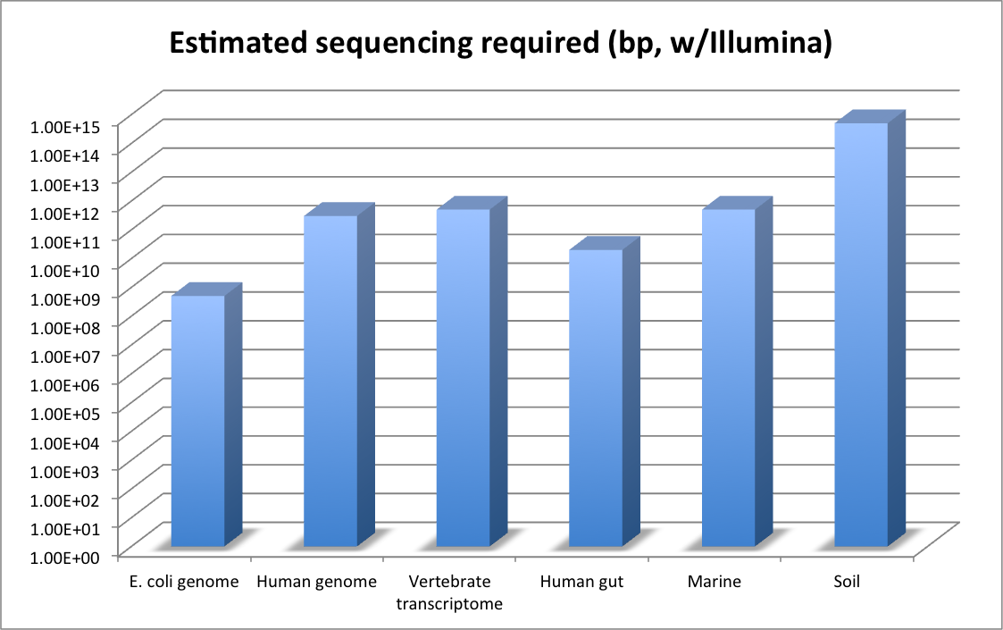
We can estimate sequencing req’d:
http://ivory.idyll.org/blog/how-much-sequencing-is-needed.html

Slide 18
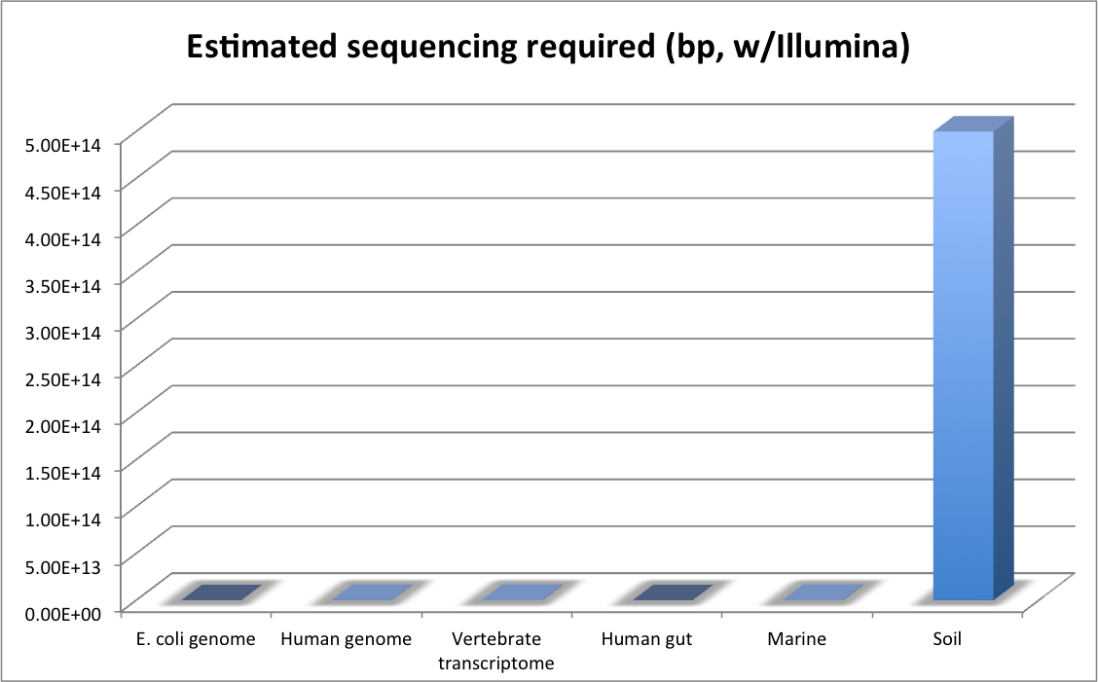
“Whoa, that’s a lot of data…”
http://ivory.idyll.org/blog/how-much-sequencing-is-needed.html

Slide 19
Some approximate metagenome sizes
Deep carbon mine data set: 60 Mbp (x 10x => 600 Mbp)
Great Prairie soil: 12 Gbp (4x human genome)
Amazon Rain Forest Microbial Observatory soil: 26 Gbp

Slide 20
How can we scale assembly!?
We have developed two prefiltering approaches.
Essentially, we preprocess your reads and (a) normalize their coverage and (b) subdivide them by graph partition.
“We take your reads and make them better! Satisfaction guaranteed or your money back!*”
* Terms may not apply to NSF, NIH, and USDA funding bodies.

Slide 21
Approach I: Digital normalization (a computational version of library normalization)
Suppose you have a dilution factor of A (10) to B(1). To get 10x of B you need to get 100x of A! Overkill!!
This 100x will consume disk space and, because of errors, memory.
We can discard it for you…

Slide 22
We only need ~5x at each point.
“Coverage” is simply the average number of reads that overlap
each true base in genome.
Here, the coverage is ~10 – just draw a line straight down from the top through all of the reads.

Slide 23
Digital normalization

Slide 24
Digital normalization

Slide 25
Digital normalization

Slide 26
Digital normalization

Slide 27
Digital normalization

Slide 28
Digital normalization

Slide 29
A read’s median k-mer count is a good estimator of “coverage”.
This gives us a reference-free measure of coverage.

Slide 30
Digital normalization approach
A digital analog to cDNA library normalization, diginorm:
Is single pass: looks at each read only once;
Does not “collect” the majority of errors;
Keeps all low-coverage reads;
Smooths out coverage of regions.

Slide 31
Coverage before digital normalization:
(MD amplified)

Slide 32
Coverage after digital normalization:
Normalizes coverage
Discards redundancy
Eliminates majority of
errors
Scales assembly dramatically.
Assembly is 98% identical.

Slide 33
Digital normalization approach
A digital analog to cDNA library normalization, diginorm is a read prefiltering approach that:
Is single pass: looks at each read only once;
Does not “collect” the majority of errors;
Keeps all low-coverage reads;
Smooths out coverage of regions.

Slide 34
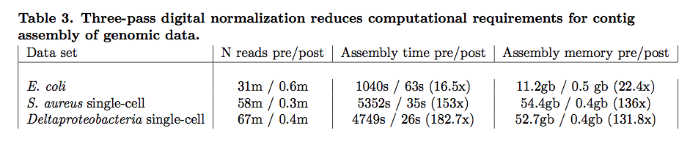
Contig assembly is significantly more efficient and now scales with underlying genome size
Transcriptomes, microbial genomes incl MDA, and most metagenomes can be assembled in under 50 GB of RAM, with identical or improved results.
Notes:
Goal is to do first stage data reduction/analysis in less time than it takes to generate the data. Compression => OLC assembly.

Slide 35
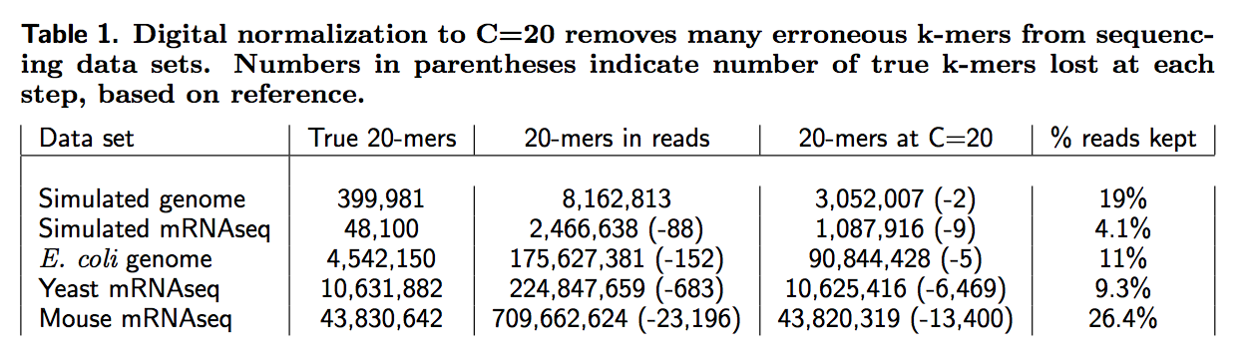
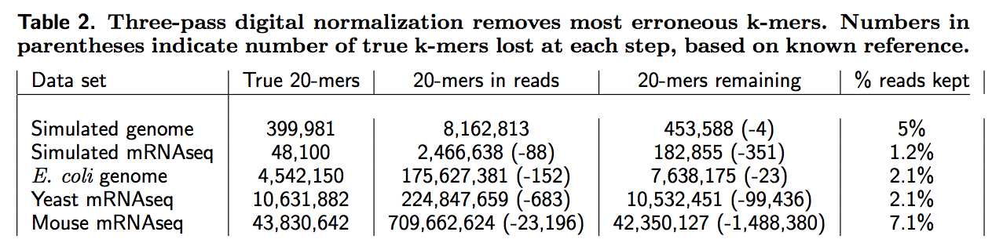
Digital normalization retains information, while discarding data and errors

Slide 36
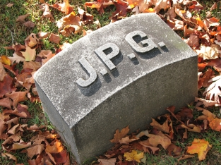
Lossy compression
http://en.wikipedia.org/wiki/JPEG

Slide 37

Lossy compression
http://en.wikipedia.org/wiki/JPEG

Slide 38

Lossy compression
http://en.wikipedia.org/wiki/JPEG

Slide 39

Lossy compression
http://en.wikipedia.org/wiki/JPEG

Slide 40
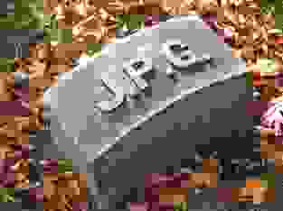
Lossy compression
http://en.wikipedia.org/wiki/JPEG

Slide 41
~2 GB – 2 TB of single-chassis RAM
We can use lossy compression approaches to make downstream analysis faster and better.

Slide 42
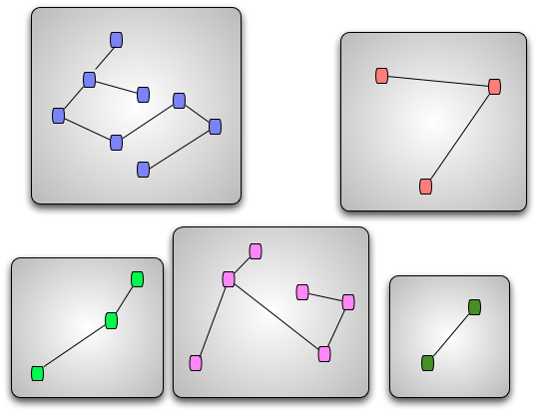
Metagenomes: Data partitioning (a computational version of cell sorting)
Split reads into “bins” belonging to different source species.
Can do this based almost entirely on connectivity of sequences.
“Divide and conquer”
Memory-efficient implementation helps to scale assembly.
Pell et al., 2012, PNAS

Slide 43
Partitioning separates reads by genome.
When computationally spiking HMP mock data with one E. coli genome (left) or multiple E. coli strains (right), majority of partitions contain reads from only a single genome (blue) vs multi-genome partitions (green).
*
*
Partitions containing spiked data indicated with a *
Adina Howe

Slide 44
Partitioning: Technical challenges met (and defeated)
Novel data structure properties elucidated via percolation theory analysis (Pell et al., 2012, PNAS).
Exhaustive in-memory traversal of graphs containing 5-15 billion nodes.
Sequencing technology introduces false sequences in graph (Howe et al., submitted.)
Only 20x improvement in assembly scaling ☹.

Slide 45
Is your assembly good?
Truly reference-free assembly is hard to evaluate.
Traditional “genome” measures like N50 and NG50 simply do not apply to metagenomes, because very often you don’t know what the genome “size” is.

Slide 46
Evaluating assembly
Evaluating correctness of metagenomes is still undiscovered country.

Slide 47
Evaluating assemblies
Every assembly returns different results for eukaryotic genomes.
For metagenomes, it’s even worse.
No systematic exploration of precision, recall, etc.
Very little in the way of cross-comparable data sets
Often sequencing technology being evaluated is out of date
etc. etc.

Slide 48
Our experience
Our metagenome assemblies compare well with others, but we have little in the way of ground truth with which to evaluate.
Scaffold assembly is tricky; we believe in contig assembly for metagenomes, but not scaffolding.
See arXiv paper, “Assembling large, complex metagenomes”, for our suggested pipeline and statistics & references.

Slide 49
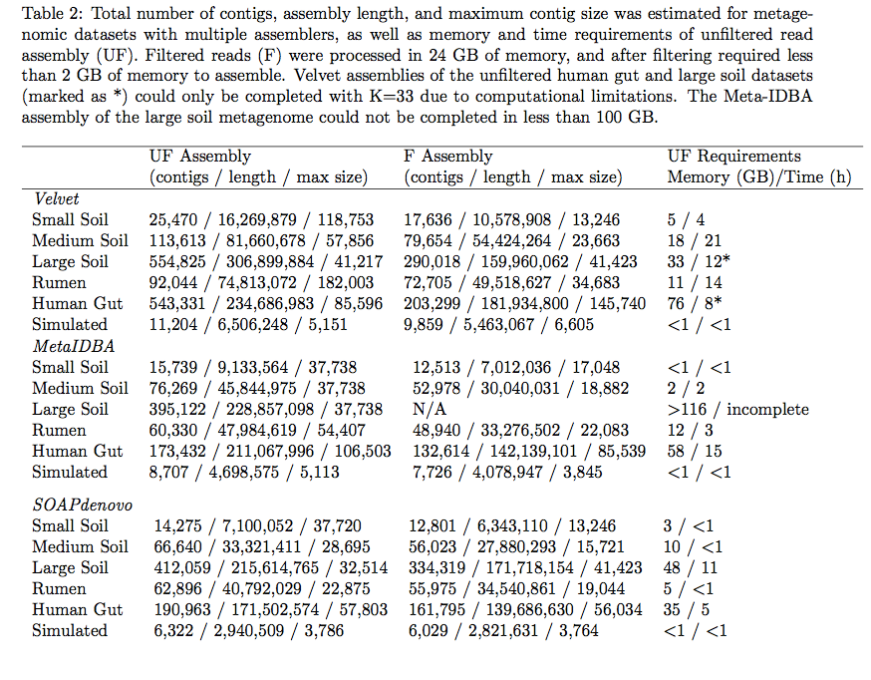
Metagenomic assemblies are highly variable
Adina Howe et al., arXiv 1212.0159

Slide 50
How to choose a metagenome assembler
Try a few.
Use what seems to perform best (most bp > some minimum)
I’ve heard/read good things about
MetaVelvet
Ray Meta
IDBA-UD
Our pipeline doesn’t specify an assembler.

Slide 51
The Kalamazoo Metagenome Assembly Pipeline

Slide 52
Diginorm

Slide 53
Diginorm
Partitioning

Slide 54
Thoughts on our pipeline
Should work with any metagenome; very generic approach.
Diginorm can be decoupled from partitioning;
People report that diginorm “just works”;
Partitioning is trickier and only needed for REALLY BIG data sets.
Diginorm does interact with some assemblers in a funny way, so suggest starting with Velvet and/or reinflating your partitions.
This pipeline, esp diginorm part, is faster and lower memory than any other assembler out there (well, except maybe Minia).

Slide 55
Deep Carbon data set
Name: DCO_TCO_MM5
Masimong Gold Mine; microbial cells filtered from fracture water from within a 1.9km borehole. (32,000 year old water?!)
M.C.Y. Lau, C. Magnabosco, S. Grim, G. Lacrampe Couloume, K. Wilkie, B. Sherwood Lollar, D.N. Simkus, G.F. Slater, S. Hendrickson, M. Pullin, T.L. Kieft, O. Kuloyo, B. Linage, G. Borgonie, E. van Heerden, J. Ackerman, C. van Jaarsveld, and T.C. Onstott

Slide 56
DCO_TCO_MM5
20m reads / 2.1 Gbp
“Could you take a look at this? MG-RAST is telling us we have a lot of artificially duplicated reads, i.e. the data is bad.”
Entire process took ~4 hours of computation, or so.
(Minimum genome size est: 60.1 Mbp)
5.6m reads / 601.3 Mbp

Slide 57
Assembly stats:
DCO_TCO_MM5
 | All contigs |  |  |  | Contigs > 1kb
k | N contigs | Sum BP |  | N contigs | Sum BP | Max contig
21 | 343263 | 63217837 |  | 6271 | 10537601 | 9987
23 | 302613 | 63025311 |  | 7183 | 13867885 | 21348
25 | 276261 | 62874727 |  | 7375 | 15303646 | 34272
27 | 258073 | 62500739 |  | 7424 | 16078145 | 48742
29 | 242552 | 62001315 |  | 7349 | 16426147 | 48746
31 | 228043 | 61445912 |  | 7307 | 16864293 | 48750
33 | 214559 | 60744478 |  | 7241 | 17133827 | 48768
35 | 203292 | 60039871 |  | 7129 | 17249351 | 45446
37 | 189948 | 58899828 |  | 7088 | 17527450 | 59437
39 | 180754 | 58146806 |  | 7027 | 17610071 | 54112
41 | 172209 | 57126650 |  | 6914 | 17551789 | 65207
43 | 165563 | 56440648 |  | 6925 | 17654067 | 73231
(Minimum genome size est: 60.1 Mbp)

Slide 58
Chose two:
DCO_TCO_MM5
A: k=43 (“long contigs”)
165563 contigs
56.4 Mbp
longest contig: 73231 bp
B: k=43 (“high recall”)
343263 contigs
63.2 Mbp
longest contig is 9987 bp
How to evaluate??

Slide 59
How many reads map back?
Mapped 3.8m paired-end reads (one subsample):
high-recall: 41% of pairs map
longer-contigs: 70% of pairs map
+ 150k single-end reads:
high-recall: 49% of sequences map
longer-contigs: 79% of sequences map

Slide 60
Annotation/exploration with MG-RAST
You can upload genome assemblies to MG-RAST, and annotate them with coverage; tutorial to follow.
What does MG-RAST do?

Slide 61
Conclusion
DCO_TCO_MM5
This is a pretty good metagenome assembly – > 80% of reads map!
Surprised that the larger dataset (6.32 Mbp, “high recall”) accounts for a smaller percentage of the reads – 49% vs 79% for the 56.4 Mbp “long contigs” data set.
I now suspect that different parameters are recovering different subsets of the sample…
Don’t trust MG-RAST ADR calls.

Slide 62
A few notes --

Slide 63
You can estimate metagenome size…

Slide 64
Estimates of metagenome size
Calculation: # reads * (avg read len) / (diginorm coverage)
Assumes: few entirely erroneous reads (upper bound); saturation (lower bound).
E. coli: 384k * 86.1 / 5.0 => 6.6 Mbp est. (true: 4.5 Mbp)
MM5 deep carbon: 60 Mbp
Great Prairie soil: 12 Gbp
Amazon Rain Forest Microbial Observatory: 26 Gbp

Slide 65
Diginorm changes your coverage.
Contigs > 1kb
 |  | DN |  |  | Reinflated
k | N contigs | bp | longest | N contigs | bp | longest
21 | 24 | 441844 | 80662 | 31 | 439074 | 79170
23 | 13 | 443330 | 86040 | 24 | 437988 | 80488
25 | 12 | 443565 | 84324 | 24 | 426949 | 84286
27 | 11 | 443256 | 89835 | 23 | 385473 | 89795
29 | 11 | 443665 | 89748 | 11 | 285725 | 89809
31 | 10 | 440919 | 102131 | 11 | 286508 | 89810
33 | 12 | 432320 | 85175 | 15 | 282373 | 85210
35 | 15 | 423541 | 85177 | 15 | 276158 | 85177
37 | 14 | 352233 | 121539 | 14 | 278537 | 85184
39 | 16 | 322968 | 121538 | 10 | 276068 | 85187
41 | 20 | 393501 | 121545 | 8 | 278483 | 85211
43 | 25 | 363656 | 121624 | 6 | 278380 | 121462
http://ivory.idyll.org/blog/the-k-parameter.html

Slide 66
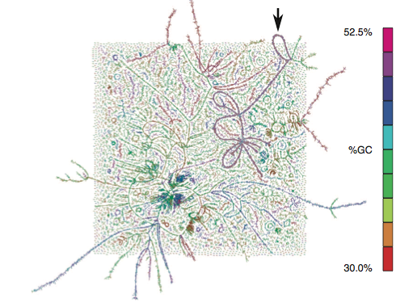
Extracting whole genomes?
So far, we have only assembled contigs, but not whole genomes.
Can entire genomes be
assembled from metagenomic
data?
Iverson et al. (2012), from
the Armbrust lab, contains a
technique for scaffolding
metagenome contigs into
~whole genomes. YES.

Slide 67
Concluding thoughts
What works?
What needs work?
What will work?

Slide 68
What works?
Today,
From deep metagenomic data, you can get the gene and operon content (including abundance of both) from communities.
You can get microarray-like expression information from metatranscriptomics.

Slide 69
What needs work?
Assembling ultra-deep samples is going to require more engineering, but is straightforward. (“Infinite assembly.”)
Building scaffolds and extracting whole genomes has been done, but I am not yet sure how feasible it is to do systematically with existing tools (c.f. Armbrust Lab).

Slide 70
What will work, someday?
Sensitive analysis of strain variation.
Both assembly and mapping approaches do a poor job detecting many kinds of biological novelty.
The 1000 Genomes Project has developed some good tools that need to be evaluated on community samples.
Ecological/evolutionary dynamics in vivo.
Most work done on 16s, not on genomes or functional content.
Here, sensitivity is really important!

Slide 71
The interpretation challenge
For soil, we have generated approximately 1200 bacterial genomes worth of assembled genomic DNA from two soil samples.
The vast majority of this genomic DNA contains unknown genes with largely unknown function.
Most annotations of gene function & interaction are from a few phylogenetically limited model organisms
Est 98% of annotations are computationally inferred: transferred from model organisms to genomic sequence, using homology.
Can these annotations be transferred? (Probably not.)
This will be the biggest sequence analysis challenge of the next 50 years.

Slide 72
What are future needs?
High-quality, medium+ throughput annotation of genomes?
Extrapolating from model organisms is both immensely important and yet lacking.
Strong phylogenetic sampling bias in existing annotations.
Synthetic biology for investigating non-model organisms?
(Cleverness in experimental biology doesn’t scale ☹)
Integration of microbiology, community ecology/evolution modeling, and data analysis.

Slide 73
Papers on our work.
2012 PNAS, Pell et al., pmid 22847406 (partitioning).
Submitted, Brown et al., arXiv:1203.4802 (digital normalization).
Submitted, Howe et al, arXiv: 1212.0159 (artifact removal from Illumina metagenomes).
Submitted, Howe et al., arXiv: 1212.2832 – Assembling large, complex environmental metagenomes.
In preparation, Zhang et al. – efficient k-mer counting.

Slide 74
Recommended reading
“Comparative metagenomic and rRNA microbial diversity characterization using archaeal and bacterial synthetic communities.” Shakya et al., pmid 23387867.
Good benchmark data set!
“The results … indicate that a single gene marker such as rRNA is a poor determinant of the community structure in metagenomic sequence data from complex communities.”

